Slide 1

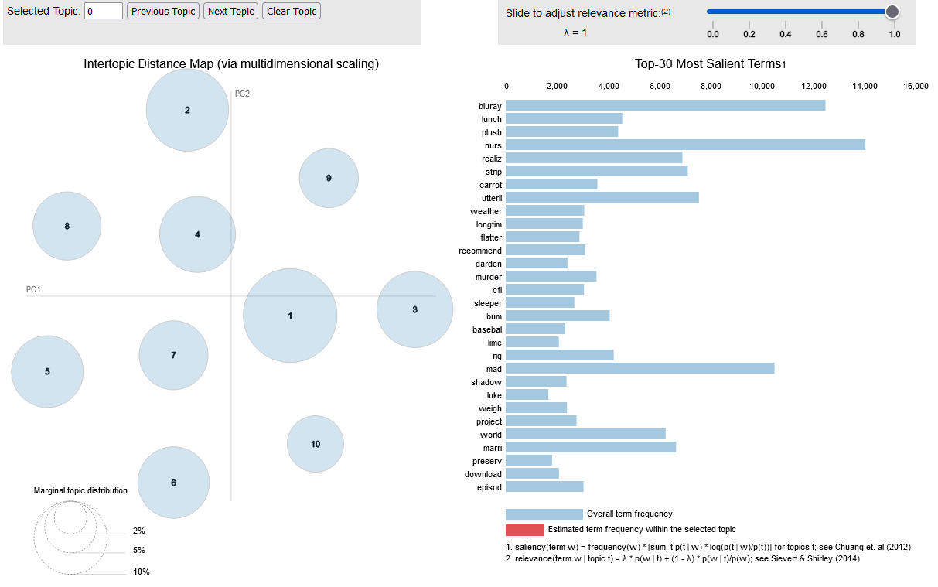
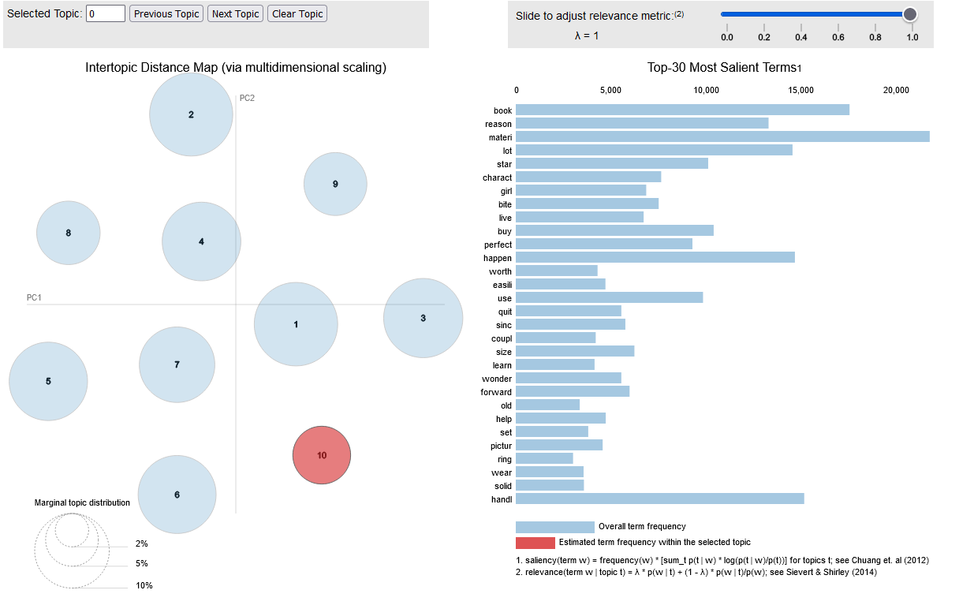
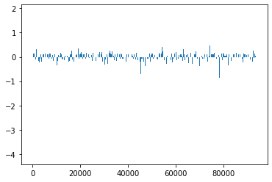
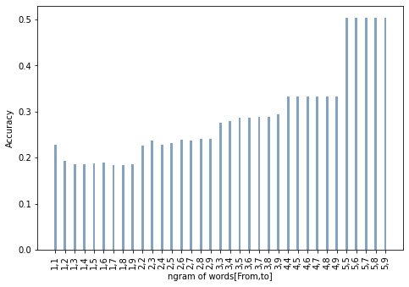
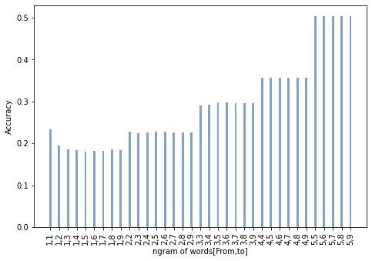
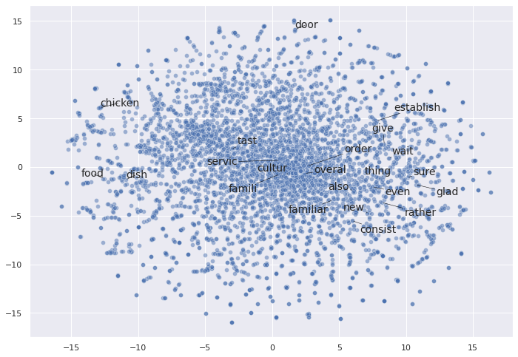
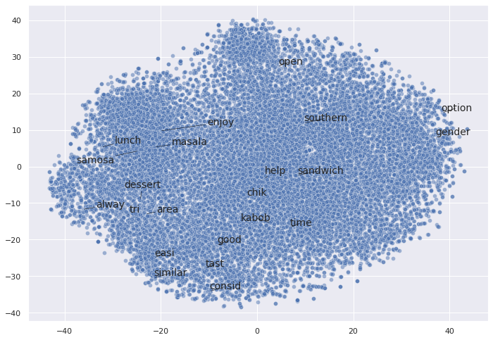
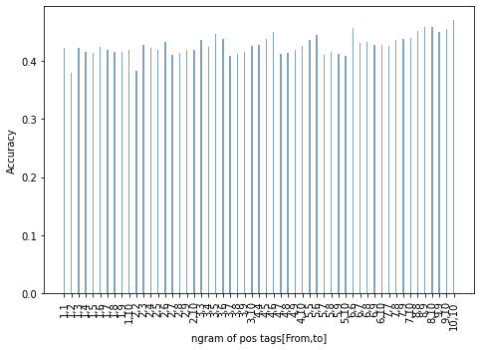
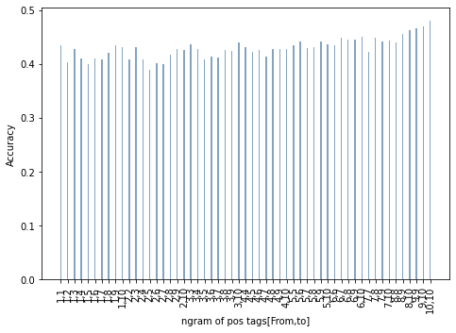
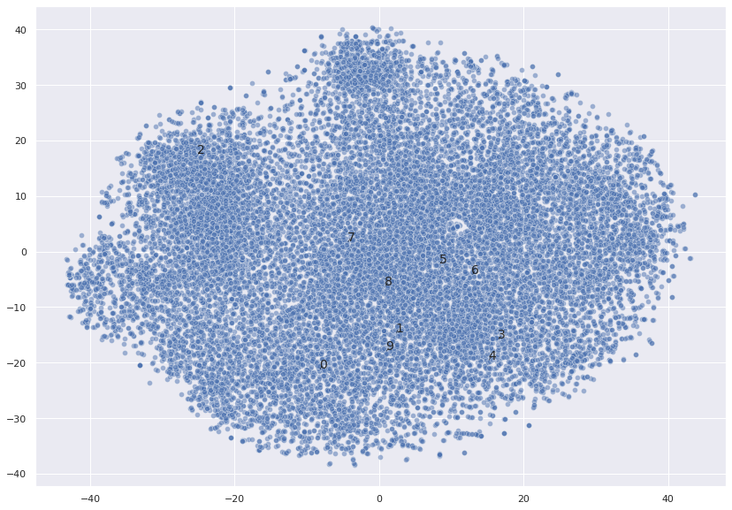
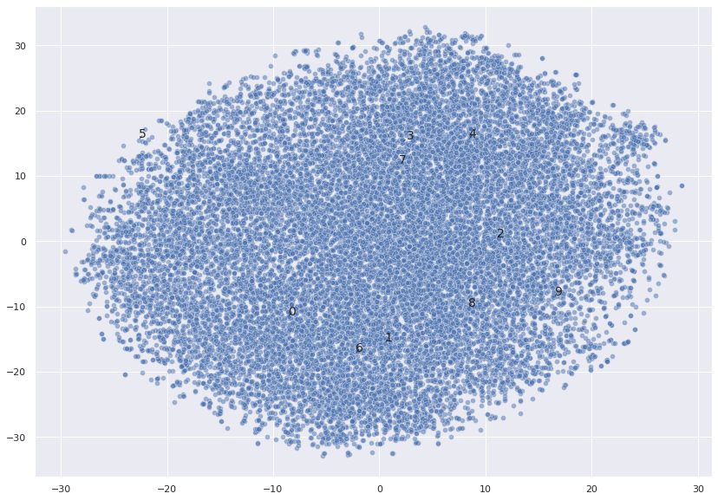
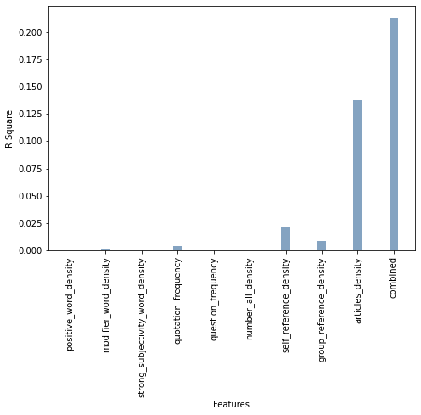
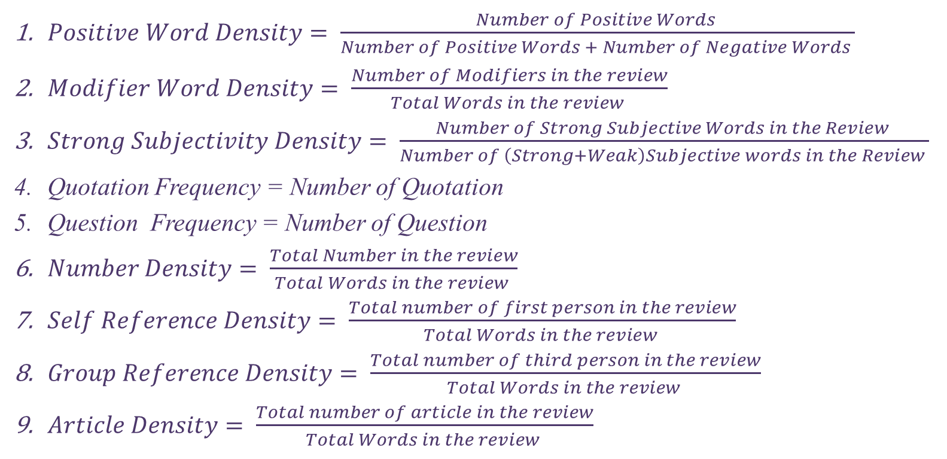
Detecting Linguistic Clues from Fake Reviews
Md Mahin (People Soft Id: 1900421)
University of Houston
Topic Modeling: Fake Vs Real
Fake
Real
Abstract
Preprocessing
Feature Importance(N-gram of Words: 1-9 gram)
This project tries to
Analyze linguistic cues from fake review datasets.
Explores two types of linguistic cues
- General linguistic cues: n-gram of words and n-gram of POS tagging
Deceptive linguistic cues
Analyze the performance of a deep learning model
Lower case conversion: Python String
Number conversion into strings: Inflect
Removal of punctuations, white spaces, and stop words removal: NLTK
Named entity removal spacy
Stemming and Lemmatization: NLTK
Other Tools Used
General Linguistic Cues: With and Without Named Entities (N-gram of Words)
Hypotheses and Objectives
POS tagging: NLTK
Word and document clustering: word2vec, genism, TSNE, Seaborn
Topic Clustering: sklearn, pyLDAvis
Logistic Regression, Linear Regression, Feature Importance: sklearn
Recurrent Convolutional Neural Network: sklearn and keras
Without
With
Analyzing properties of Fake Review Datasets
Exploring the performance of general linguistic cues using logistic regression accuracy and feature importance
Exploring the performance of deceptive linguistic cues using linear regression r-squared
Classifying fake reviews using Recurrent Convolutional Neural Network
Deep Learning Model
Datasets
Word embedding layer: 64-dimensional embedding vector
Embedding Matrix: 512 x 64
Convolutional layers: 3
Convolutional filters: 128
Kernel size: 5, followed by max-pool layer
LSTM layers: 2, 128 neurons + 10% dropout
Fully-connected layer: sigmoid activation
Computer generated fake review dataset of 40432
- Sample 40432, Real , Fake 20216, 20216
Amazon Product Review
-Sample 110, Real 55, Fake 55
Deceptive Linguistic Cue Definitions
$Positive Word Density= \frac{Number of Positive Words }{Number of Positive Words + Number of Negative Words }$
$Modifier Word Density= \frac{Number of Modifiers in the review}{Total Words in the review }$
$Strong Subjectivity Density= \frac{Number of Strong Subjective Words in the Review }{Number of \left(Strong+Weak\right)Subjective words in the Review }$
Quotation Frequency = Number of Quotation
Question Frequency = Number of Question
$Number Density= \frac{Total Number in the review}{Total Words in the review }$
$Self Reference Density= \frac{Total number of first person in the review}{Total Words in the review }$
$Group Reference Density= \frac{Total number of third person in the review}{Total Words in the review }$
$Article Density= \frac{Total number of article in the review}{Total Words in the review }$
Analysis using Word Level Clustering: Fake Vs Real
General Linguistic Cues: With and Without Named Entities (N-gram of POS Tags)
Fake
Real
With
Without
Classification using Deep Learning
Accuracy: 94%
Precision: 0.497
Recall: 1
F1-score: 0.664
Conclusions
Deep learning model performs better than simple model with different linguistic features only
More analysis needed to see how linguistic features can improve the performance of deep learning models
Analysis using Document Level Clustering: Fake Vs Real
Deceptive Linguistic Cues: With and Without Named Entities
Fake
Real
With
Without
Methodology to Create General Linguistic Cues
References
Preprocess the reviews
Generate POS tag for each word and create a separate column with tags only
Generate n-gram of cleaned reviews
Generate n-gram of tags
Generate TF-IDF of n-gram of tags
Addawood, A., Badawy, A., Lerman, K. and Ferrara, E., 2019, July. Linguistic cues to deception: Identifying political trolls on social media. In Proceedings of the international AAAI conference on web and social media (Vol. 13, pp. 15-25).
Ahmed, H., Traore, I. and Saad, S., 2017, October. Detection of online fake news using n-gram analysis and machine learning techniques. In International conference on intelligent, secure, and dependable systems in distributed and cloud environments (pp. 127-138). Springer, Cham.
https://towardsdatascience.com/fake-news-classification-with-recurrent-convolutional-neural-networks-4a081ff69f1a

Slide 2
Abstract
2
This project tries to
Analyze linguistic cues from fake review datasets.
Explores two types of linguistic cues
- General linguistic cues: n-gram of words and n-gram of POS tagging
- Deceptive linguistic cues
Analyze the performance of a deep learning model

Slide 3
Hypotheses and Objectives
3
Analyzing properties of Fake Review Datasets
Exploring the performance of general linguistic cues using logistic regression accuracy and feature importance
Exploring the performance of deceptive linguistic cues using linear regression r-squared
Classifying fake reviews using Recurrent Convolutional Neural Network

Slide 4
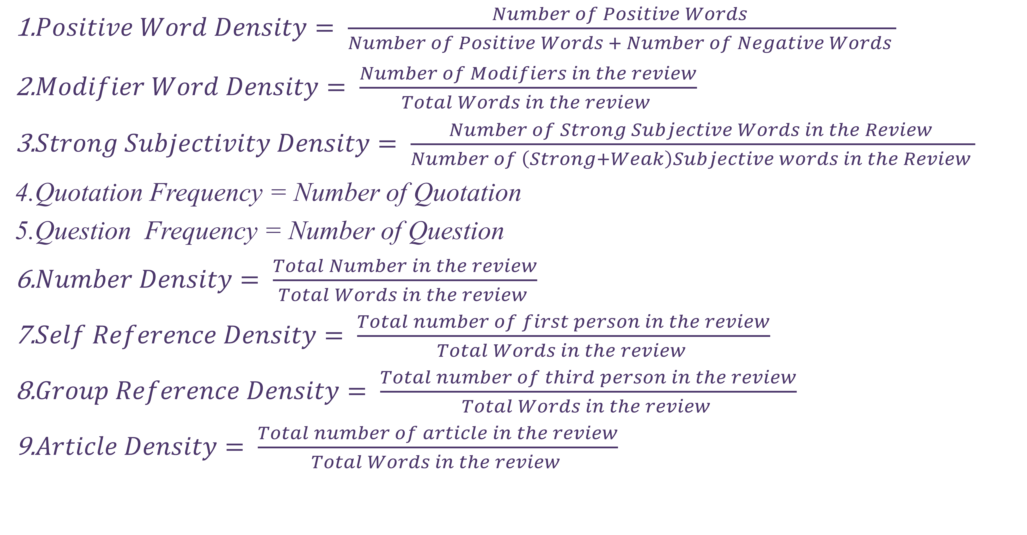
Deceptive Linguistic Cue Definitions
4
$Positive Word Density= \frac{Number of Positive Words }{Number of Positive Words + Number of Negative Words }$
$Modifier Word Density= \frac{Number of Modifiers in the review}{Total Words in the review }$
$Strong Subjectivity Density= \frac{Number of Strong Subjective Words in the Review }{Number of \left(Strong+Weak\right)Subjective words in the Review }$
Quotation Frequency = Number of Quotation
Question Frequency = Number of Question
$Number Density= \frac{Total Number in the review}{Total Words in the review }$
$Self Reference Density= \frac{Total number of first person in the review}{Total Words in the review }$
$Group Reference Density= \frac{Total number of third person in the review}{Total Words in the review }$
$Article Density= \frac{Total number of article in the review}{Total Words in the review }$

Slide 5
Preprocessing
5
Lower case conversion: Python String
Number conversion into strings: Inflect
Removal of punctuations, white spaces, and stop words removal: NLTK
Named entity removal spacy
Stemming and Lemmatization: NLTK

Slide 6
Other Tools Used
6
POS tagging: NLTK
Word and document clustering: word2vec, genism, TSNE, Seaborn
Topic Clustering: sklearn, pyLDAvis
Logistic Regression, Linear Regression, Feature Importance: sklearn
Recurrent Convolutional Neural Network: sklearn and keras

Slide 7
Datasets
7
Computer generated fake review dataset of 40432
- Sample 40432, Real , Fake 20216, 20216
Amazon Product Review
-Sample 110, Real 55, Fake 55
Both datasets are merged into one

Slide 8
Analysis using Word Level Clustering: Fake Vs Real
8
Fake
Real

Slide 9
Analysis using Document Level Clustering: Fake Vs Real
9
Fake
Real

Slide 10
Topic Modeling: Fake Vs Real
10
Fake
Real

Slide 11
General Linguistic Cues: With and Without Named Entities (N-gram of Words)
11
With
Without

Slide 12
General Linguistic Cues: With and Without Named Entities (N-gram of POS Tags)
12
With
Without

Slide 13
Deceptive Linguistic Cues: With and Without Named Entities
13
With
Without

Slide 14
Feature Importance(N-gram of Words: 1-9 gram)
14

Slide 15
Deep Learning Model
15
Word embedding layer: 64-dimensional embedding vector
Embedding Matrix: 512 x 64
Convolutional layers: 3
Convolutional filters: 128
Kernel size: 5, followed by max-pool layer
LSTM layers: 2, 128 neurons + 10% dropout
Fully-connected layer: sigmoid activation

Slide 16
Classification using Deep Learning
16
Accuracy: 94%
Precision: 0.497
Recall: 1
F1-score: 0.664

Slide 17
Conclusions
17
Deep learning model performs better than simple model with different linguistic features only
More analysis needed to see how linguistic features can improve the performance of deep learning models

Slide 18
References
18
Addawood, A., Badawy, A., Lerman, K. and Ferrara, E., 2019, July. Linguistic cues to deception: Identifying political trolls on social media. In Proceedings of the international AAAI conference on web and social media (Vol. 13, pp. 15-25).
Ahmed, H., Traore, I. and Saad, S., 2017, October. Detection of online fake news using n-gram analysis and machine learning techniques. In International conference on intelligent, secure, and dependable systems in distributed and cloud environments (pp. 127-138). Springer, Cham.
https://towardsdatascience.com/fake-news-classification-with-recurrent-convolutional-neural-networks-4a081ff69f1a

